Slide 1
EmpowHer
EmpowHER: Empowering Girls for Corporate Excellence Soft Skill Curriculum – Git and GitHub

Slide 2
Agenda
Git and GitHub Basics
Key Git Concepts
Git Workflow
Hands On with Git

Slide 3
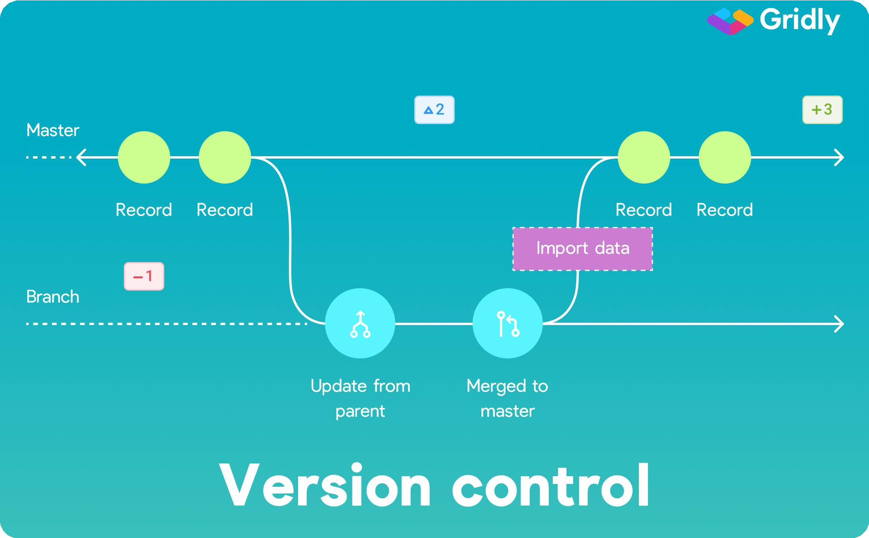

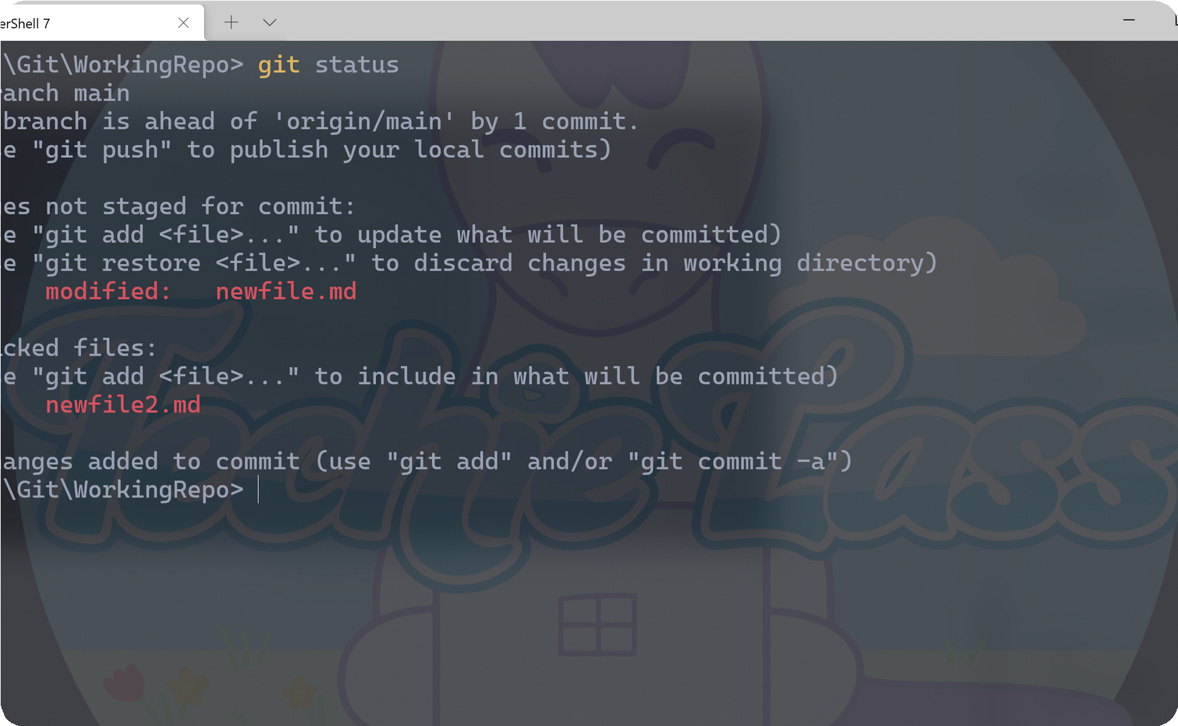
Git and GitHub Basics
Git and Github are essential tools for developers and teams that want to work on projects efficiently and collaboratively.
Version Control
Git provides powerful tools for managing different versions of code, which makes it easier to track changes and manage conflicts.
Collaborating on a Project with Git
Collaborating on projects becomes easier with git. You can collaborate on a project regardless of the location and be sure that everyone has the latest version of the code.
Working with Git Commands
Start working with git and be amazed by its flexibility. T h e s e t u p g u i d e i s g i v e n b e l o w .
Setup Guide : Please click here to open the guide.

Slide 4
Key Git Concepts
Repository:
A repository is a central location where Git stores all the files, history, and metadata related to a project.
Commit:
A commit represents a snapshot of the project at a specific point in time.
It records the changes made to the files in the repository, along with a commit message describing the changes.
Branch:
A branch is a separate line of development within a repository.
It allows multiple versions of the project to exist simultaneously, enabling developers to work on different features or bug fixes independently.
Merge:
Merge is the process of combining changes from one branch into another.

Slide 5
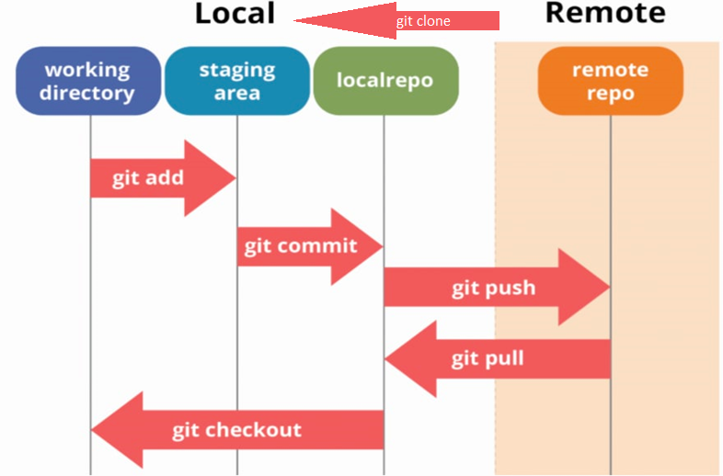
Git Workflow Diagram

Slide 6
Git Workflow
Clone: Creating a local copy of a repository
Check Out: switch between different branches in a Git repository.
Commit: Saving changes with a message
Push: Publishing changes to a remote repository
Fork: Creating a personal copy of a repository under your own GitHub account
Add: Staging changes for commit

Slide 7
Git Branches and Merges
Branching and merging are crucial aspects of Git that facilitate efficient parallel development and seamless integration of changes.
Parallel Development
Isolation and Experimentation
Collaboration and Code Review
Feature Development and Bug Fixes
Merging Changes
Conflict Resolution

Slide 8
Hands On with Git

Slide 9
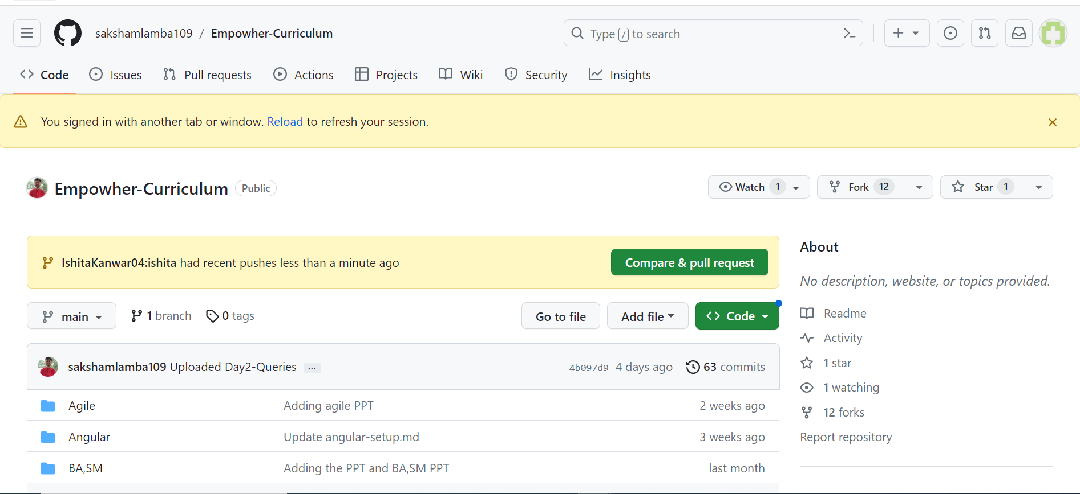
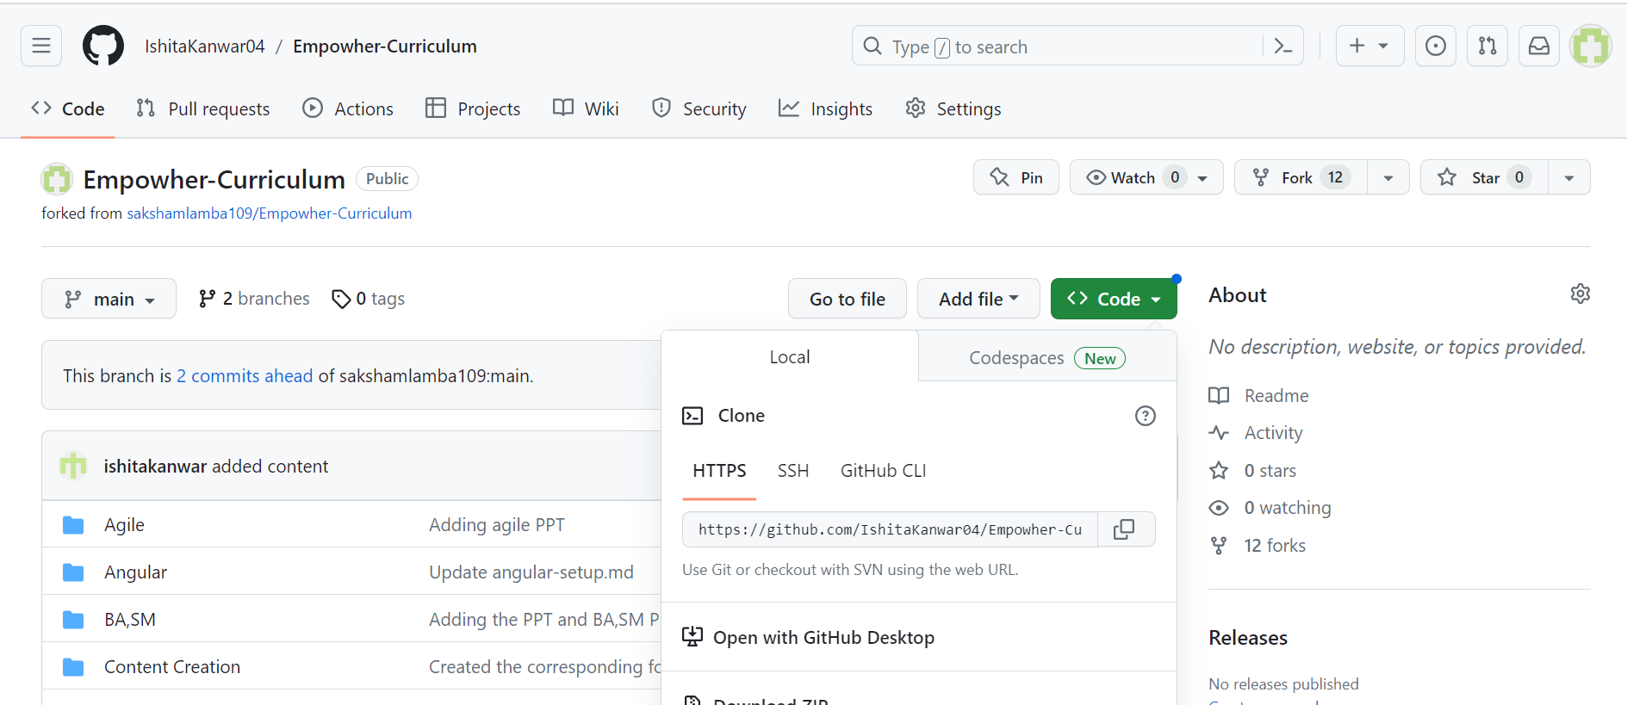
Login to your GitHub account and navigate to https://github.com/sakshamlamba109/Empowher-Curriculum
Create your own copy of the repository by clicking the Fork button.
Navigate to the forked repository in your repositories and copy the link to clone the repository.
Open git bash in the folder where you want the project to be setup and clone the repository.
Create a new practice folder and add a new file to it.
git clone <repository link>

Slide 10
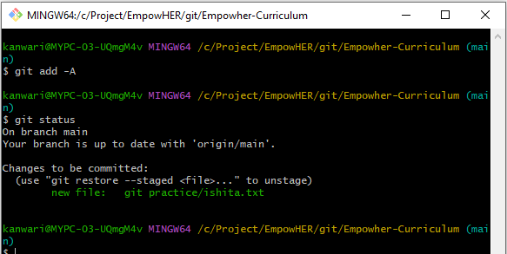
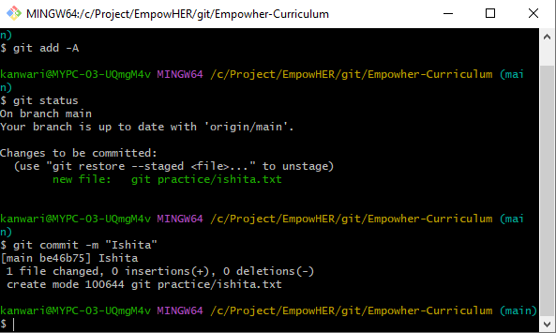
Create a new practice folder and add a new file to it.
Use the command git add -A to add all the files in the folder to the staging area.
Use the command git status to check the files that have been modified.
Use the command git commit -m "Commit message" to commit the changes and add a message describing what you did

Slide 11
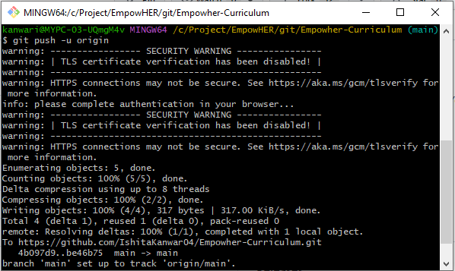
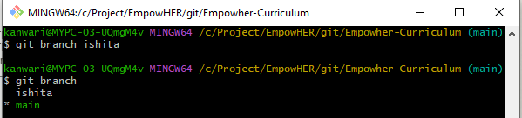
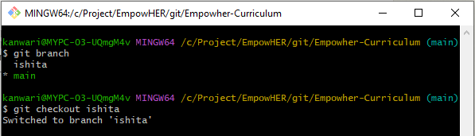
Use the command git push –u origin to push the changes to your Github repository.
To create a new branch use the command git branch <branchname>
Check the existing branches using the command git branch.
To change the branch use command git checkout <branchname>.

Slide 12
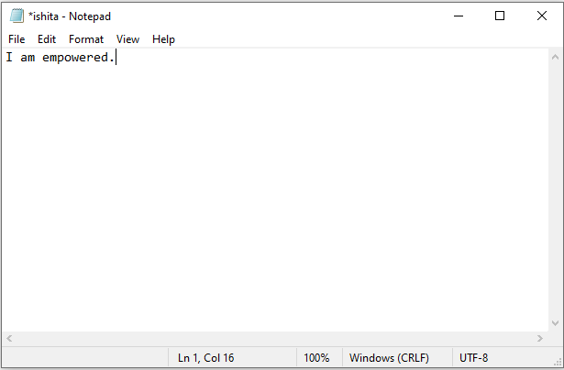
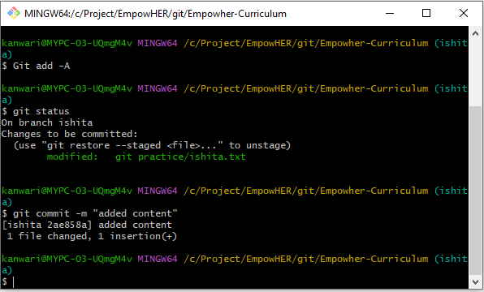
Open the file that you created and add some content to it.
Use the following commands to commit the changes.
git add -A
git commit -m “message”
Check the existing branches using the command git branch.
To change the branch use command git checkout <branchname>.

Slide 13
Open the file that you created and add some content to it.
Use the following commands to commit the changes.
git add -A
git commit -m “message”

Slide 14
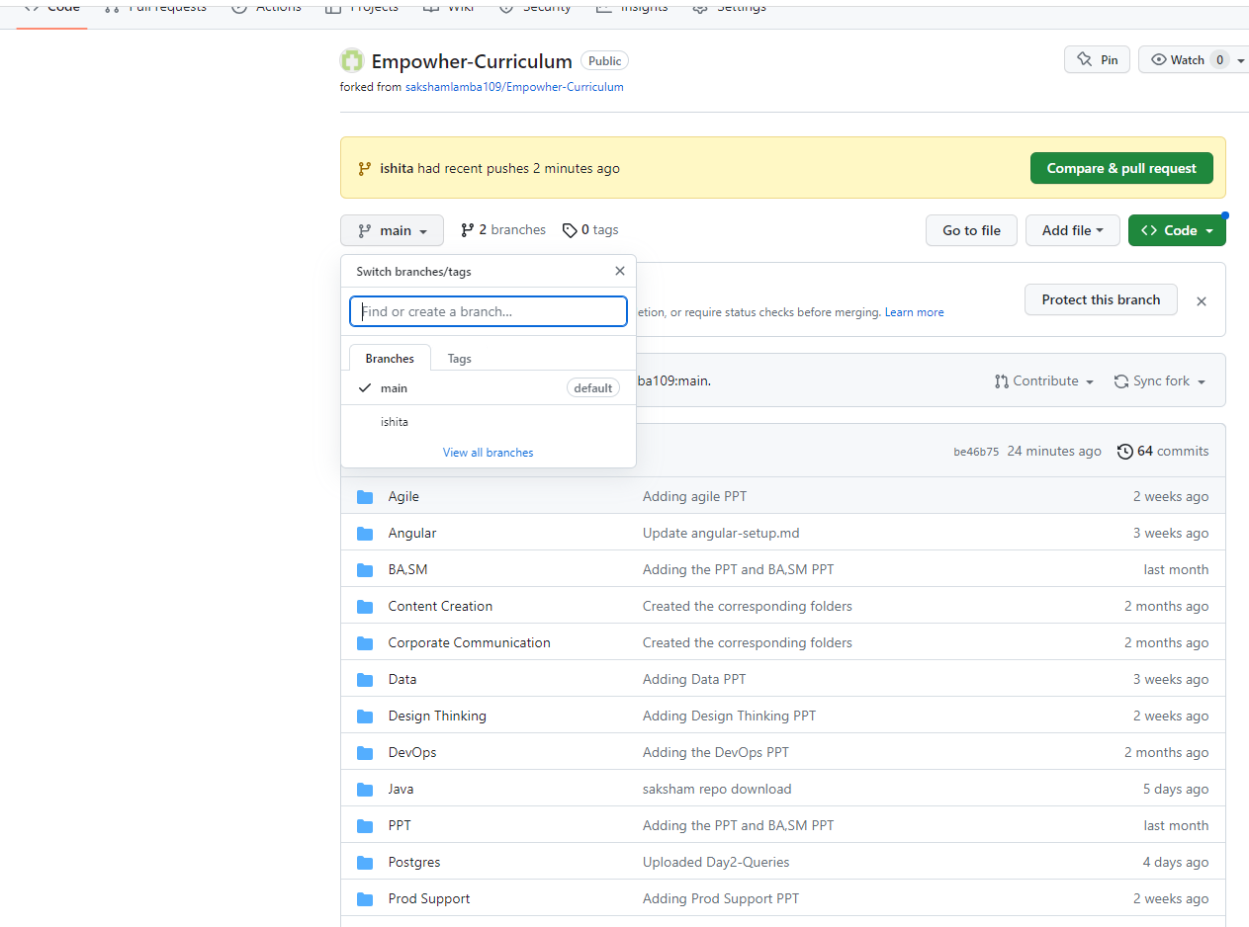
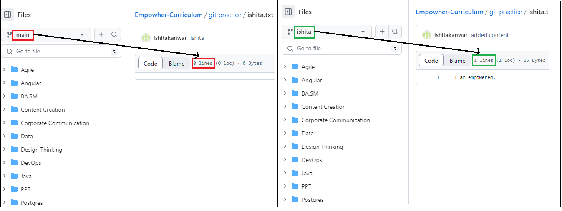
Use the command git push –set-upstream origin <branchname> to push the newly created branch.
You can see the newly created branch on github.
The new branch has the latest code, while the main branch does not.

Slide 15
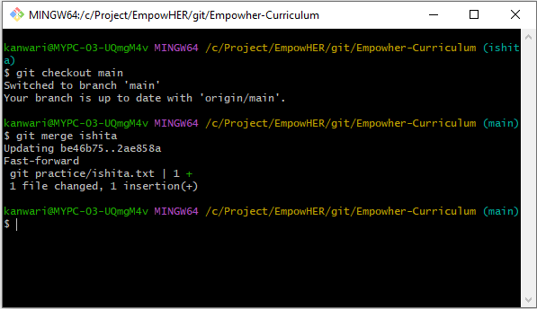
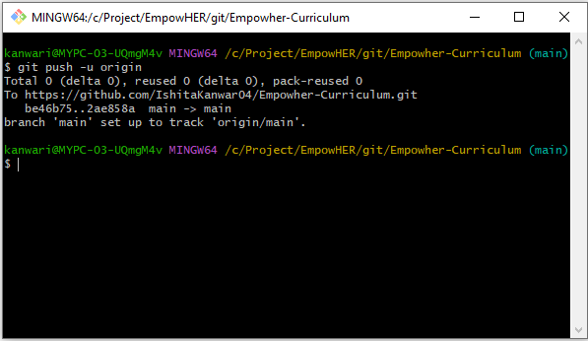
In order to merge the changes from new branch to main branch, checkout to the main branch using git checkout main.
Merge the changes using git merge <branchname>
Push the changes to remote repository using git push -u origin.

Slide 16
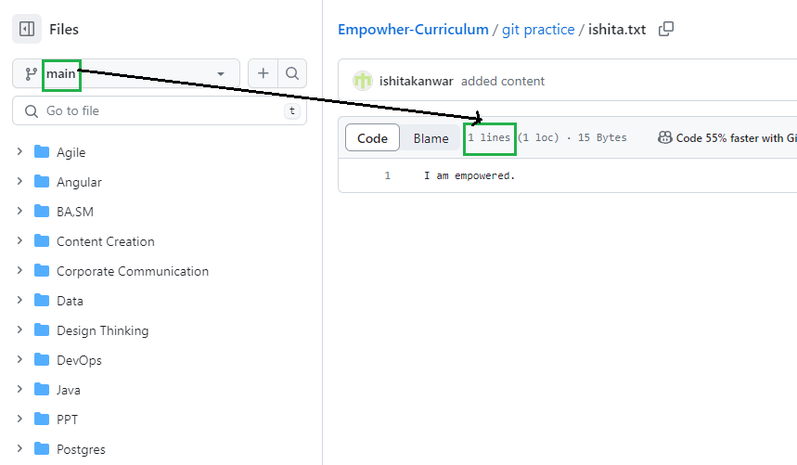
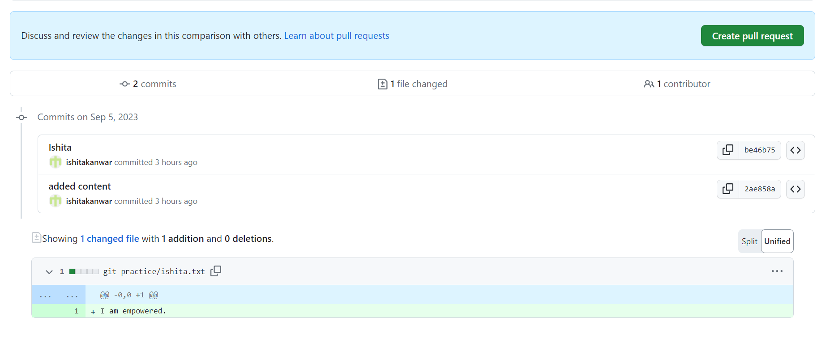
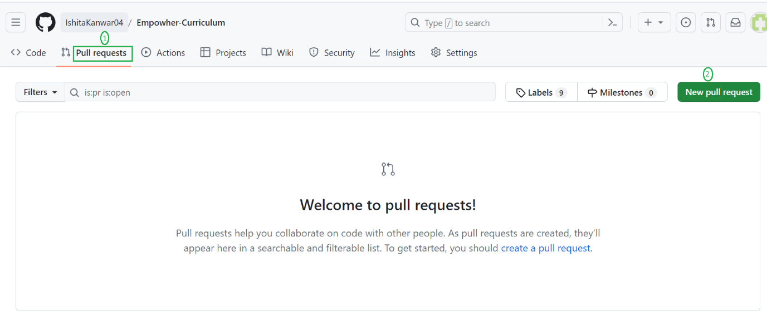
The code has been merged to the main branch.
To create a pull request, click on New pull request under the Pull Requests tab on github.
Finally, click on create pull request.

